Slide 1
Real Estate Market of 9 French Cities 2015-2019
Group member:
Jing Fei XU
Michael WARNER
Suet Wah CHU

Slide 2
Design Concept
Data Cleaning
Dashboard Design
Audience’s Needs
Removing duplicated data and outliers
Replacing null values
Graph, Colour, Font
Simple, Clear, Interactive

Slide 3
Data Cleaning - Summary
For files "2015_real_estate_transactions", “2016_real_estate_transactions”, 2017_real_estate_transactions, “2018_real_estate_transactions”
Merging of duplicate rows
Exact duplicates
Semi duplicates
Sale Type
Kept only Sale and Sale Before Completion transactions
Local Type
Kept only Apartment and House type Transactions
Renamed from Local Type to Property Type
Postal Code
Exclude "null"
Changed “number” type to "Zip Code/Postcode"
Living Area
Exclude "null" and “0”
Land Area
"null" values were replaced with "0"
Excluded apartments whos land areas are greater than 1,000 sq meters
Price
Changed type to "Decimal"
Exclude "null" and outliers:
Price < 50,000
Price > 100,000,000
Cities
Changed data type from “string” to “Geographic City”
Number of Rooms
Excluded “null” and “0”
Excluded all rooms greater than 15

Slide 4
Data Cleaning - Summary Continued
For files "2015_real_estate_transactions", “2016_real_estate_transactions”, 2017_real_estate_transactions, “2018_real_estate_transactions” (Continued)
Number of Lots
Excluded all lots greater than 15
Removal of Columns
Address
Table Names
For file "2019_real_estate_transactions":
The same steps were done to this file, including the creation of the column “City”

Slide 5
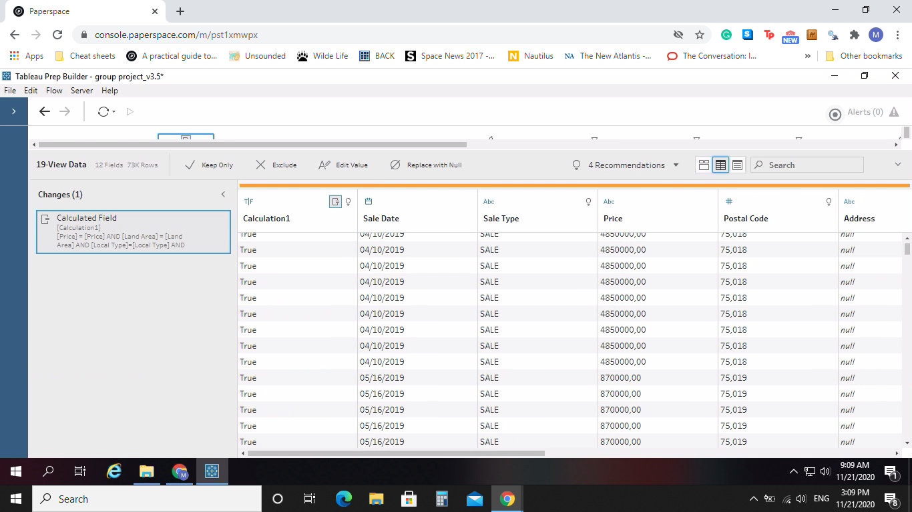
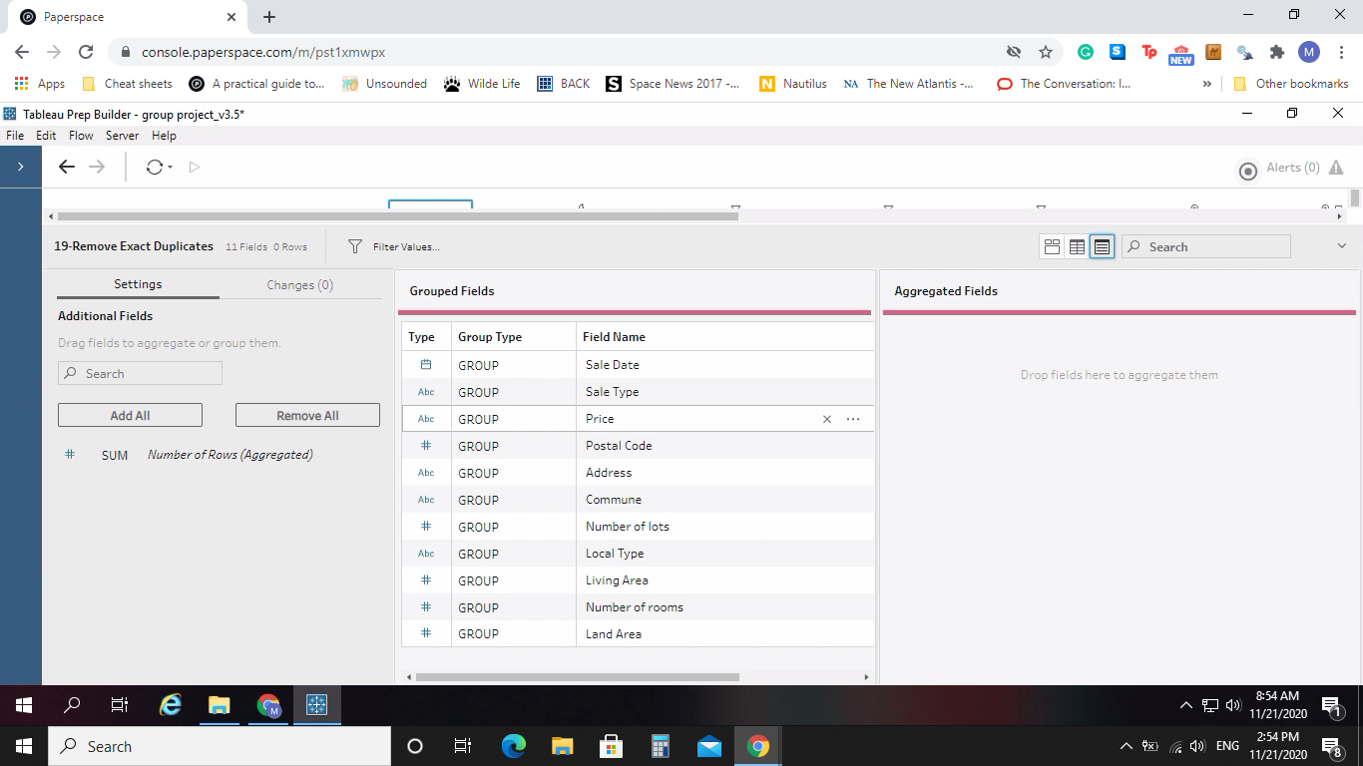
Duplicated Rows - Exact
Data Cleaning
Details
It was seen that there are rows that are exactly duplicated. They were condensed into one row through aggregations through grouping all columns.

Slide 6
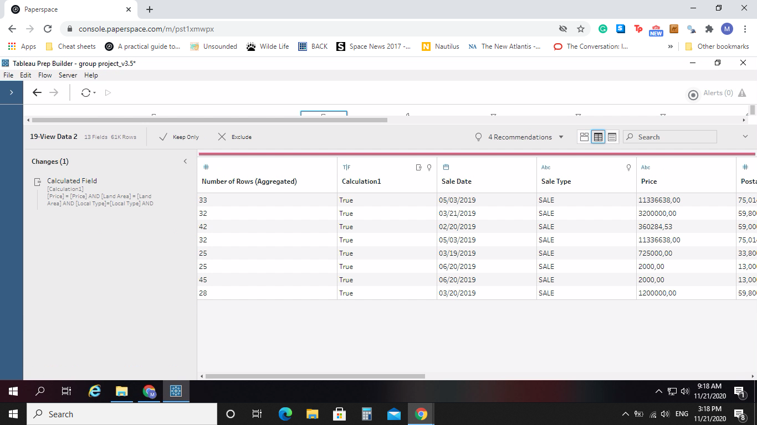
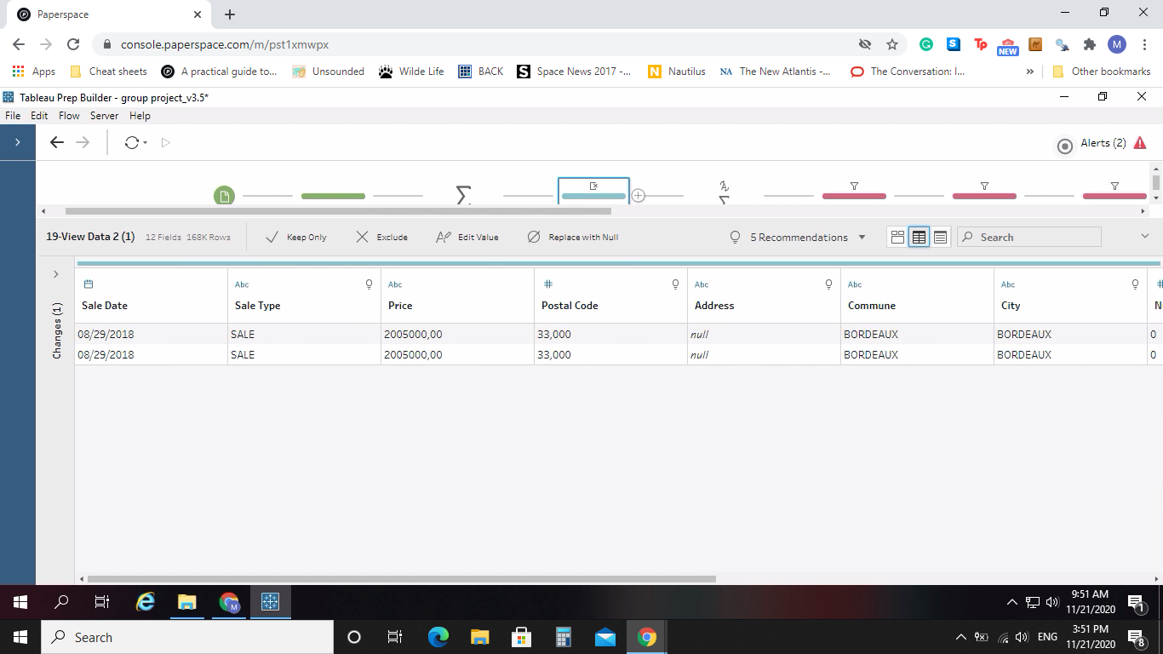

Duplicated Rows - Semi
When we checked to make sure that those rowers were condensed to one row, it was noticed that there were semi duplicates. These duplicates had the same sales date, price and city, but other variables were different. After talking to the data provider, it was decided that those rows had data entry errors and were also condensed to one row.

Slide 7

Duplicated Rows - Semi
After deciding this, we noticed that Addresses, Living Areas, Number of Rooms, Land Area, Local Type, Number of Lots and Postal Code had different values, when they should have the same. These rows were aggregated with each other to reduce the semi duplicated rows into one row.

Slide 8
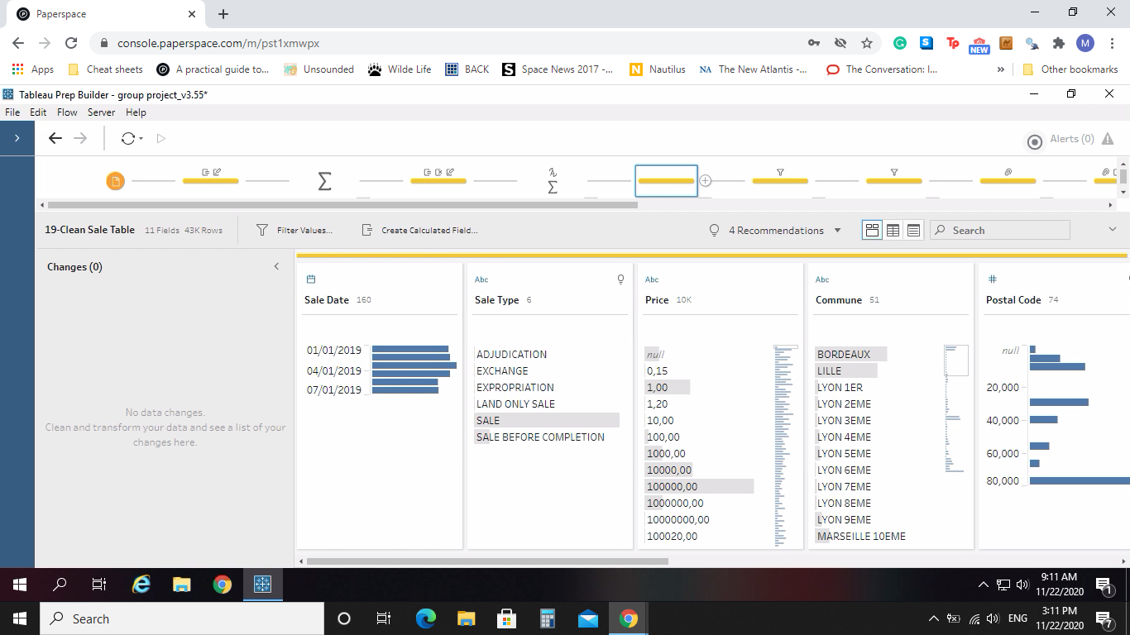
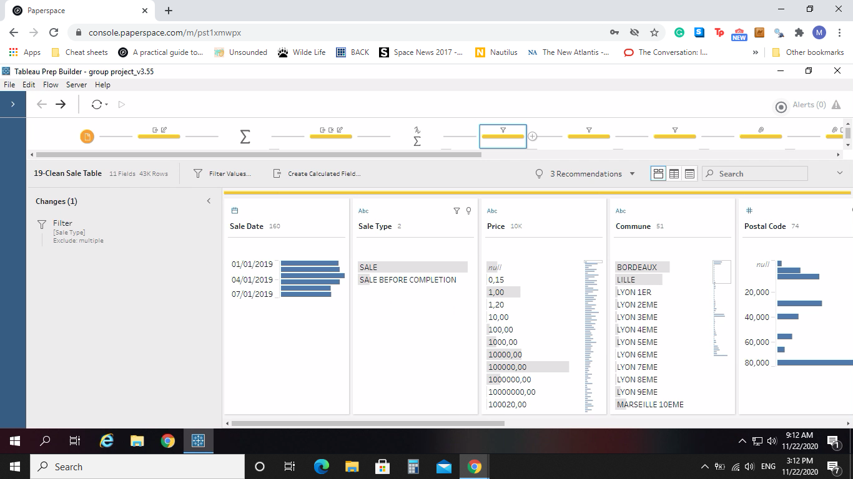
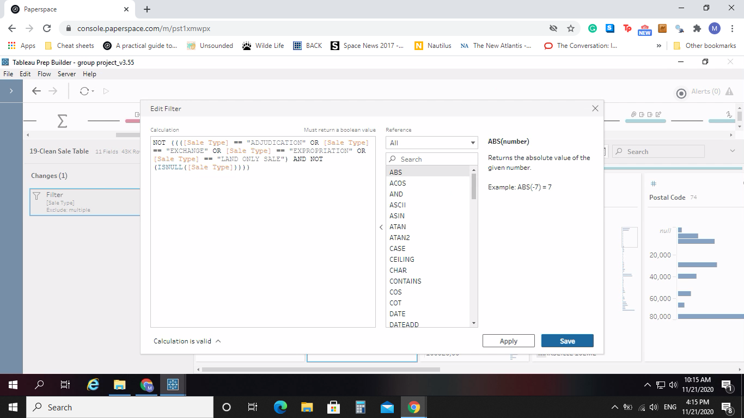
Sales Type
After the condensing of all duplicates into one row, the cleaning of the data row by row started. We began with Sales Types and the removal of Adjudication, Exchange, Expropriation and Land Only Sale data types

Slide 9
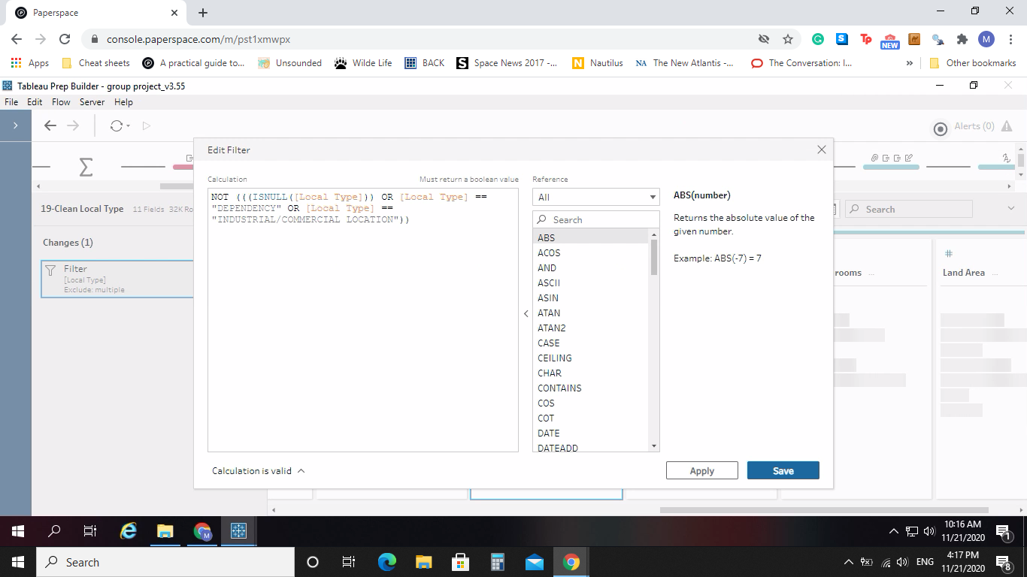
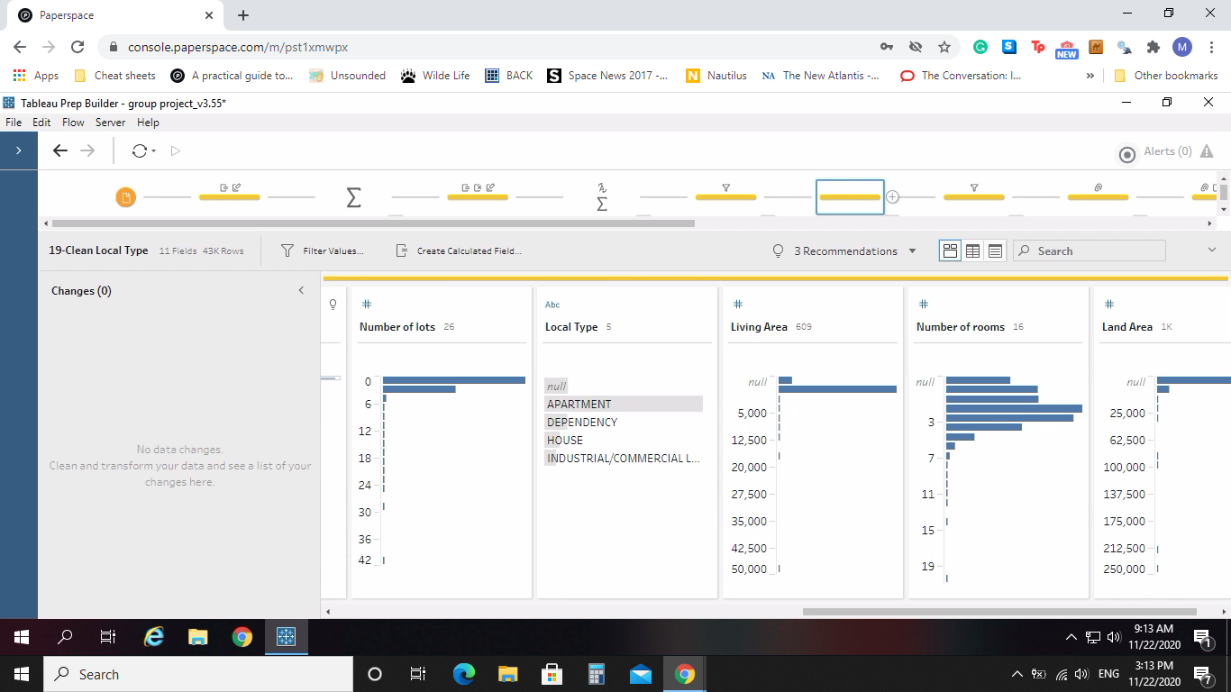
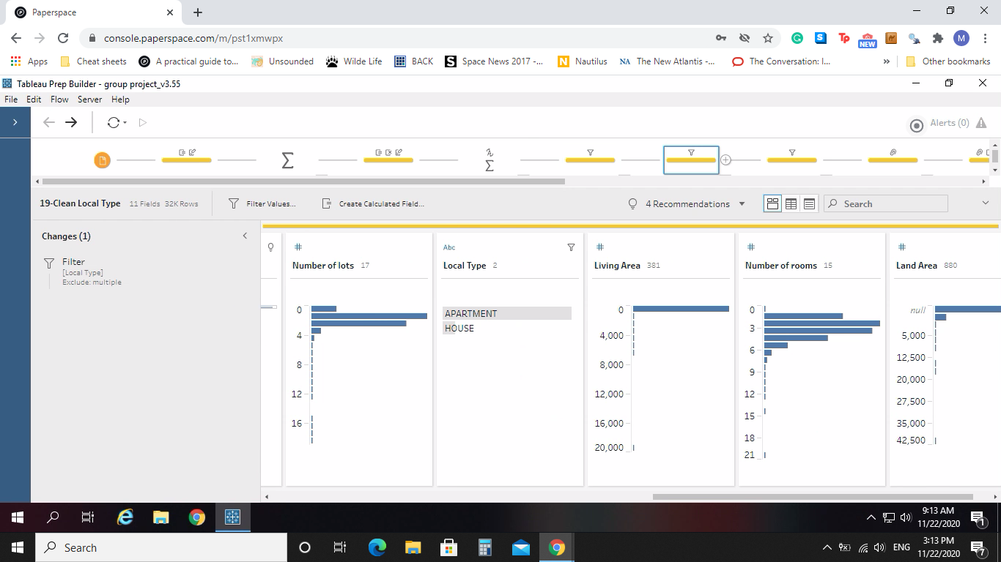
Local Type
Removal of Null, Dependency and Industrial/Commercial Location

Slide 10
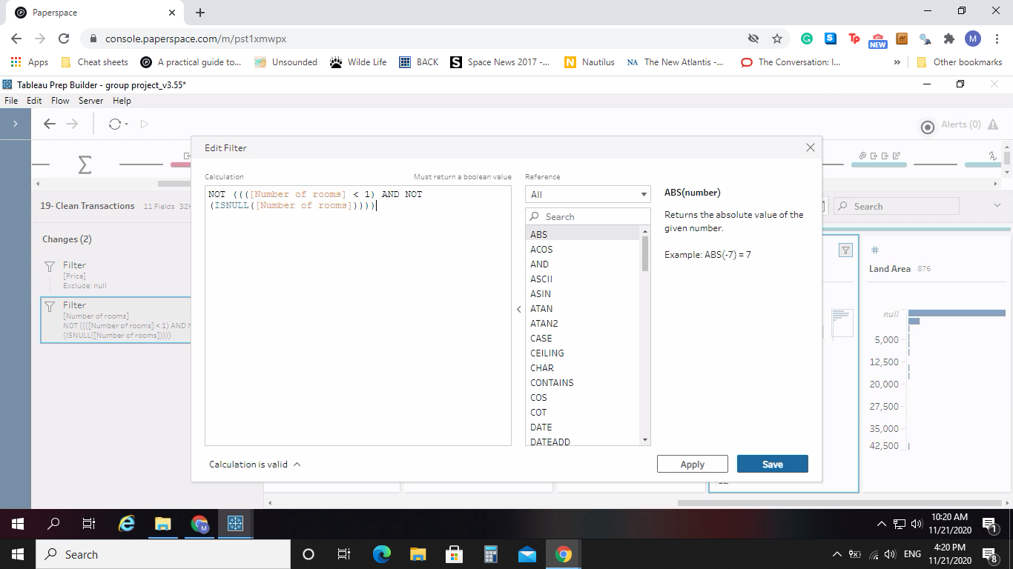
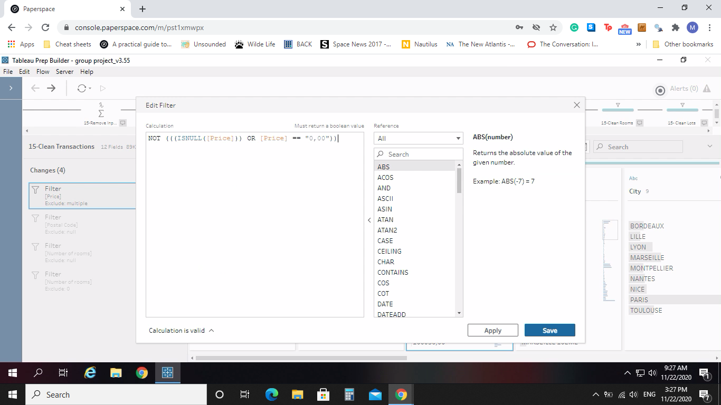
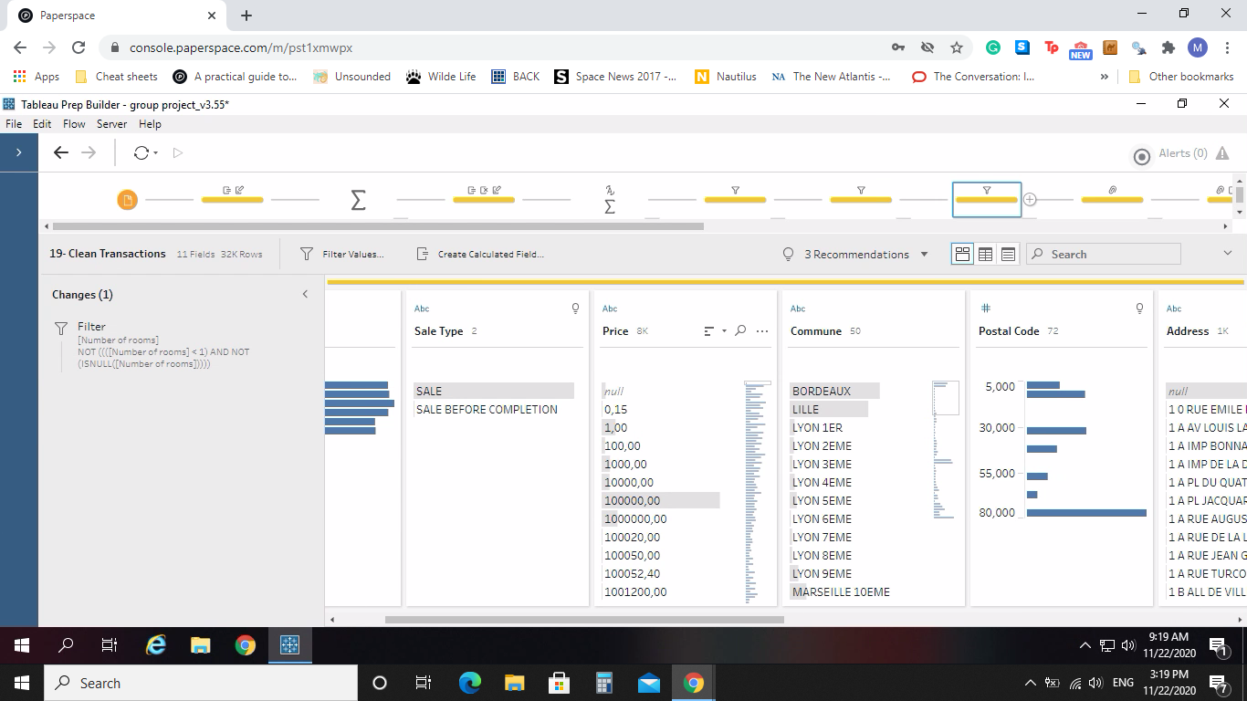
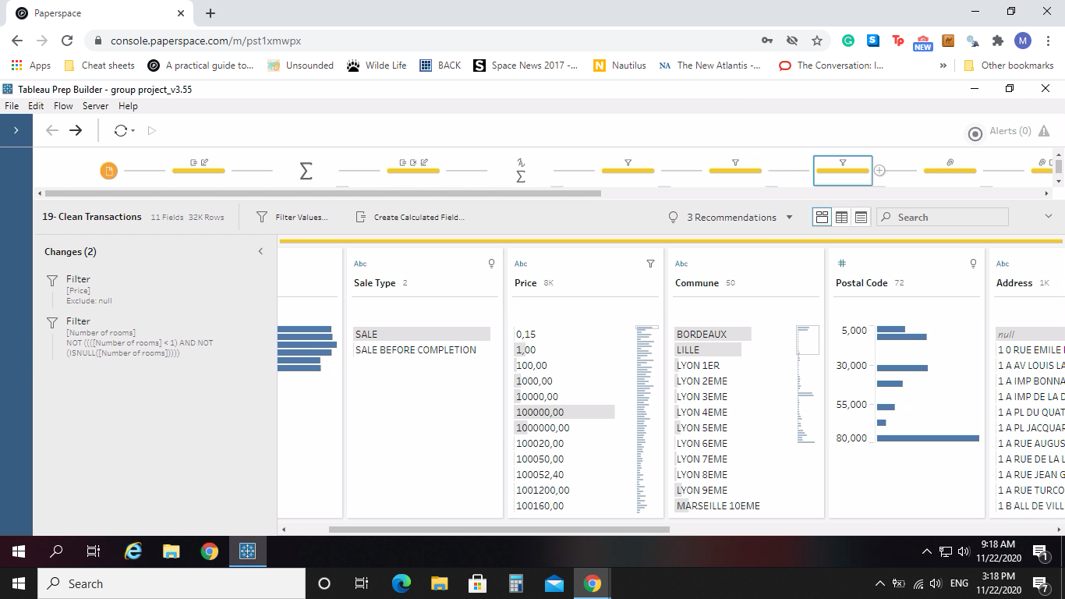
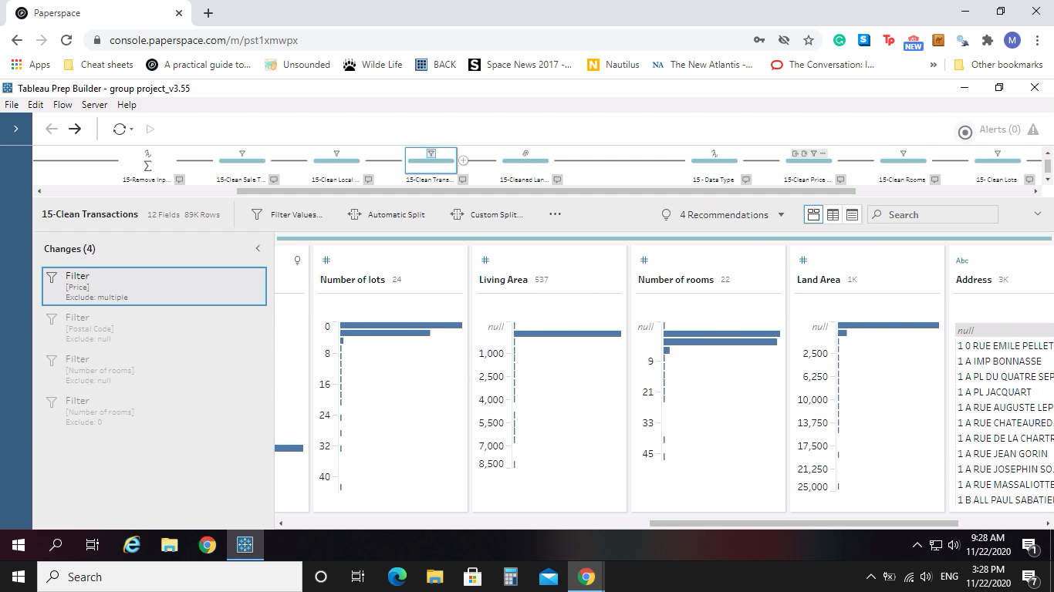
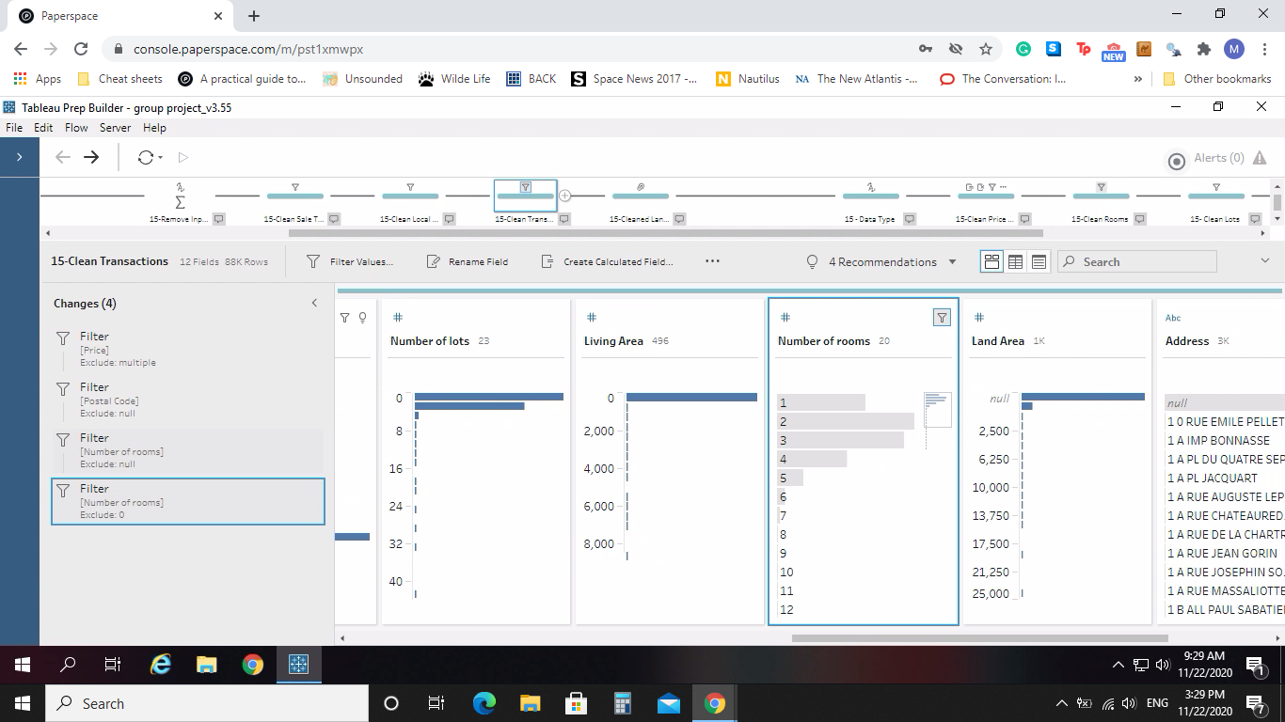
Zero or Null Values
Then we checked Number of Rooms, Price, Postal Code, or Living Area for transactions that had a null value or a 0 value, these were removed.

Slide 11

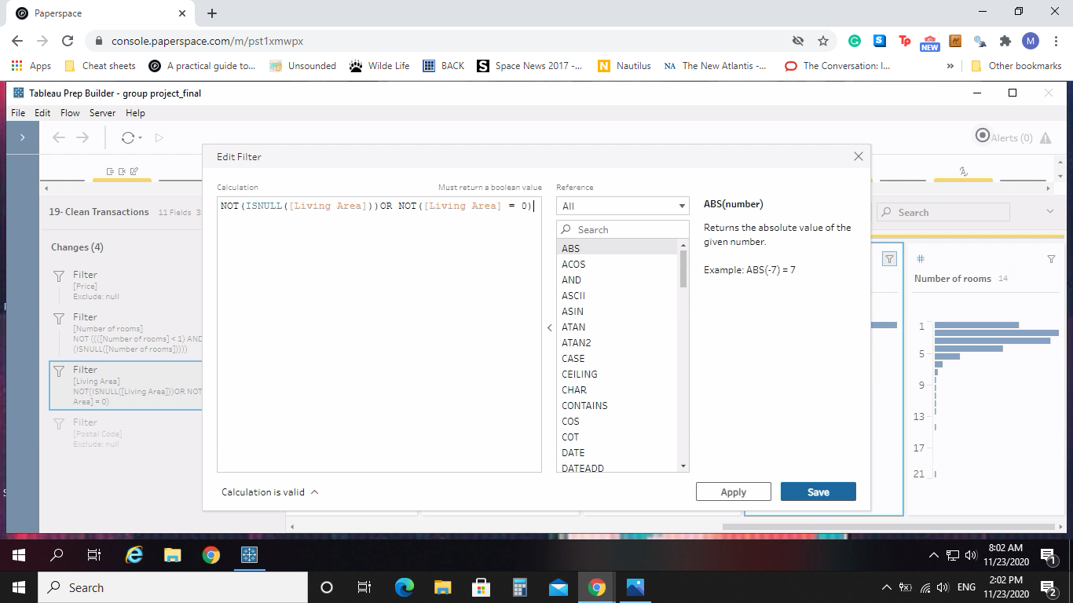
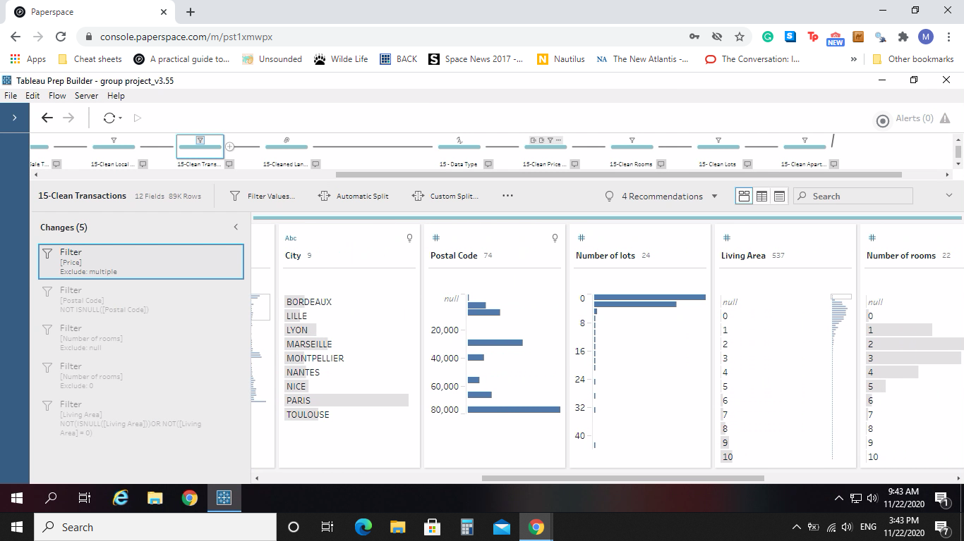
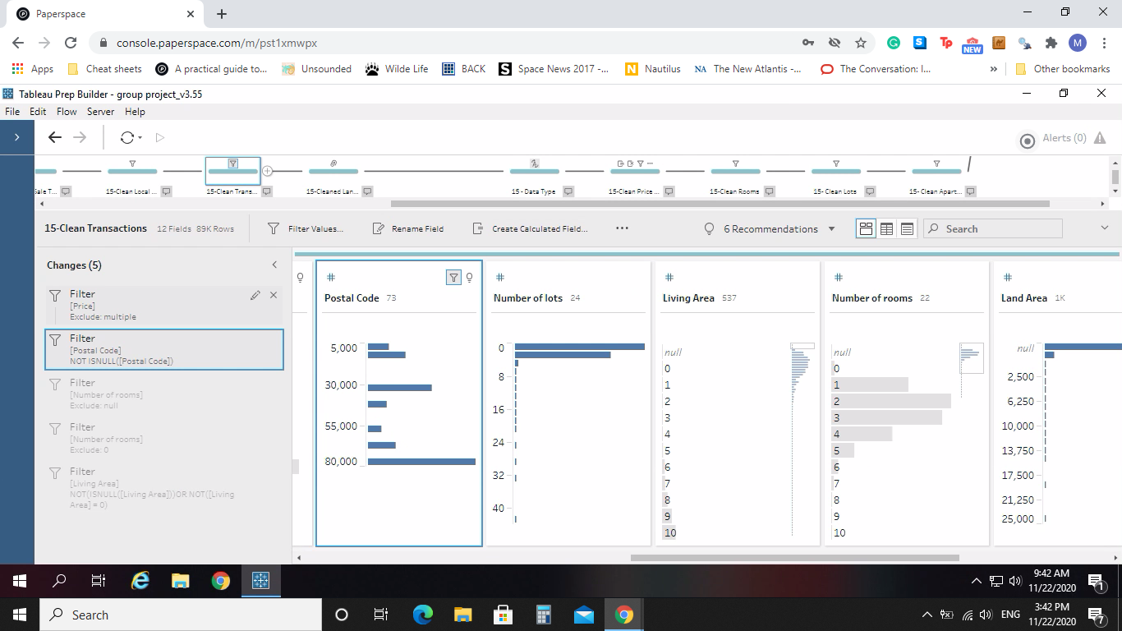
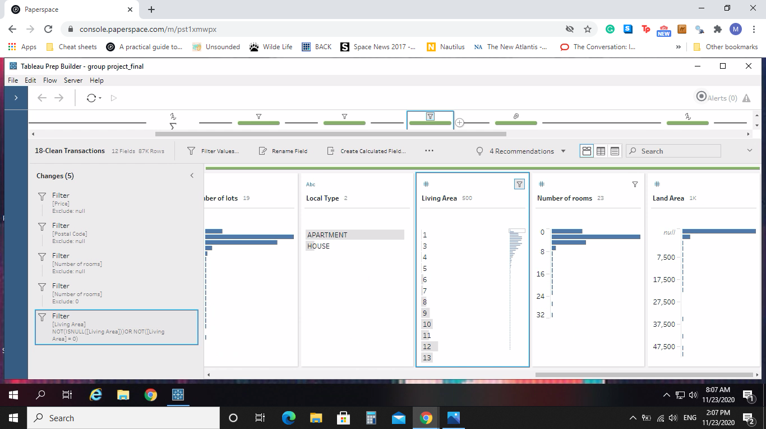
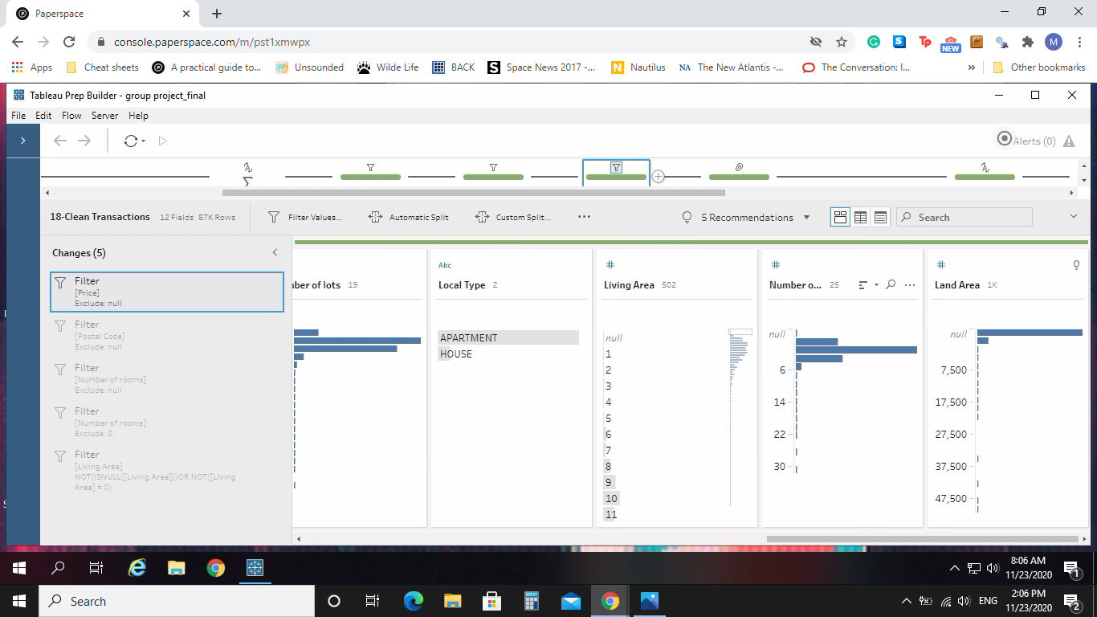
Zero or Null Values

Slide 12
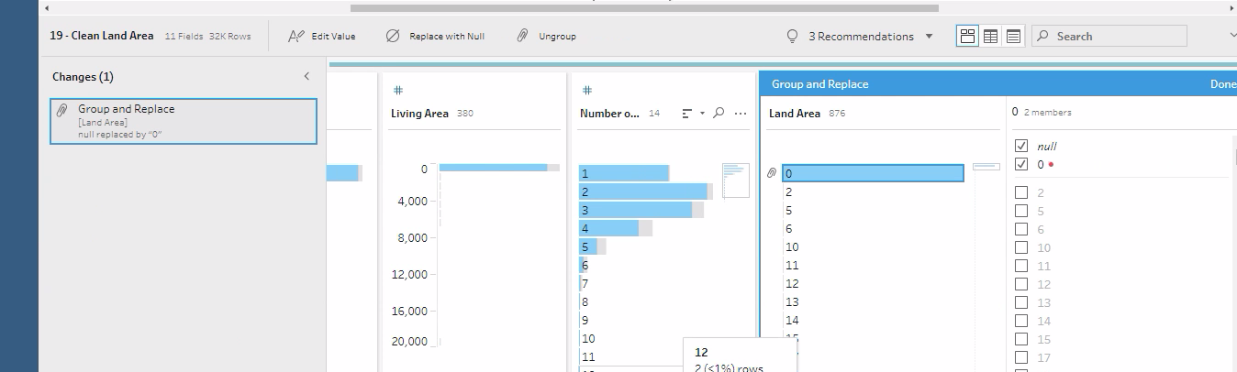
Land Area
If the Land Area data column had a data value that was null, it was replaced with a 0

Slide 13
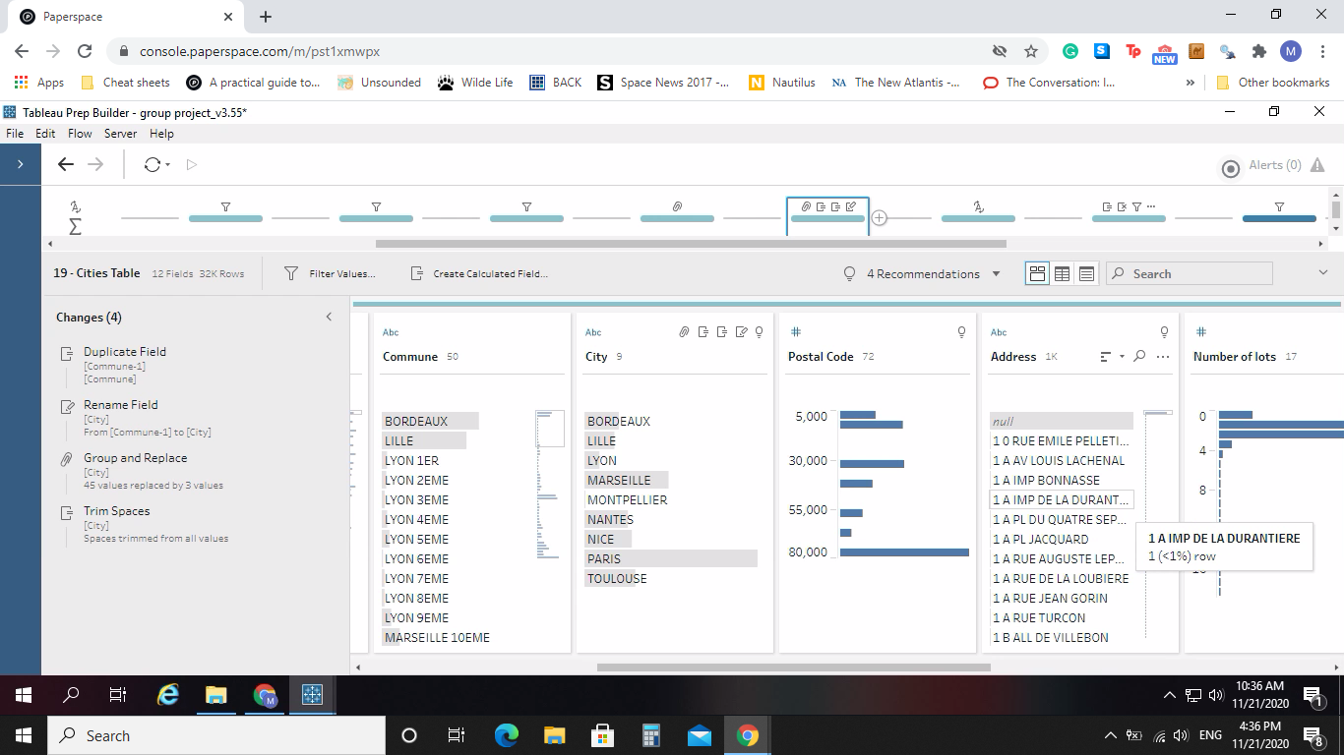
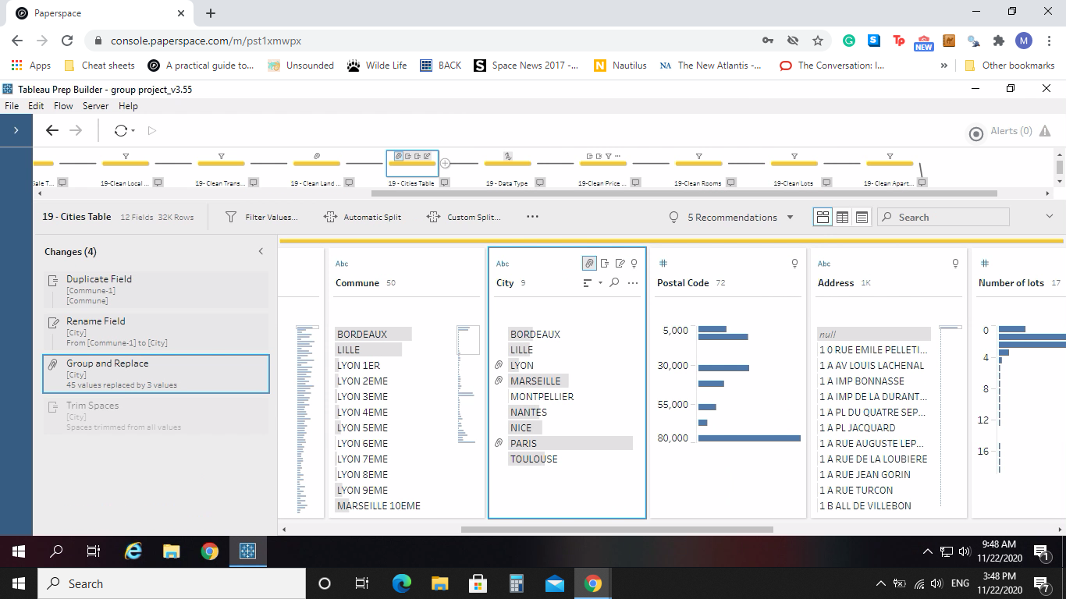
Local Type
It was noticed that for the data from 2019 did not have a cities column while the rest of the years did. For 2019, the city column was created by duplicating the commune column and that was grouped based on location.

Slide 14
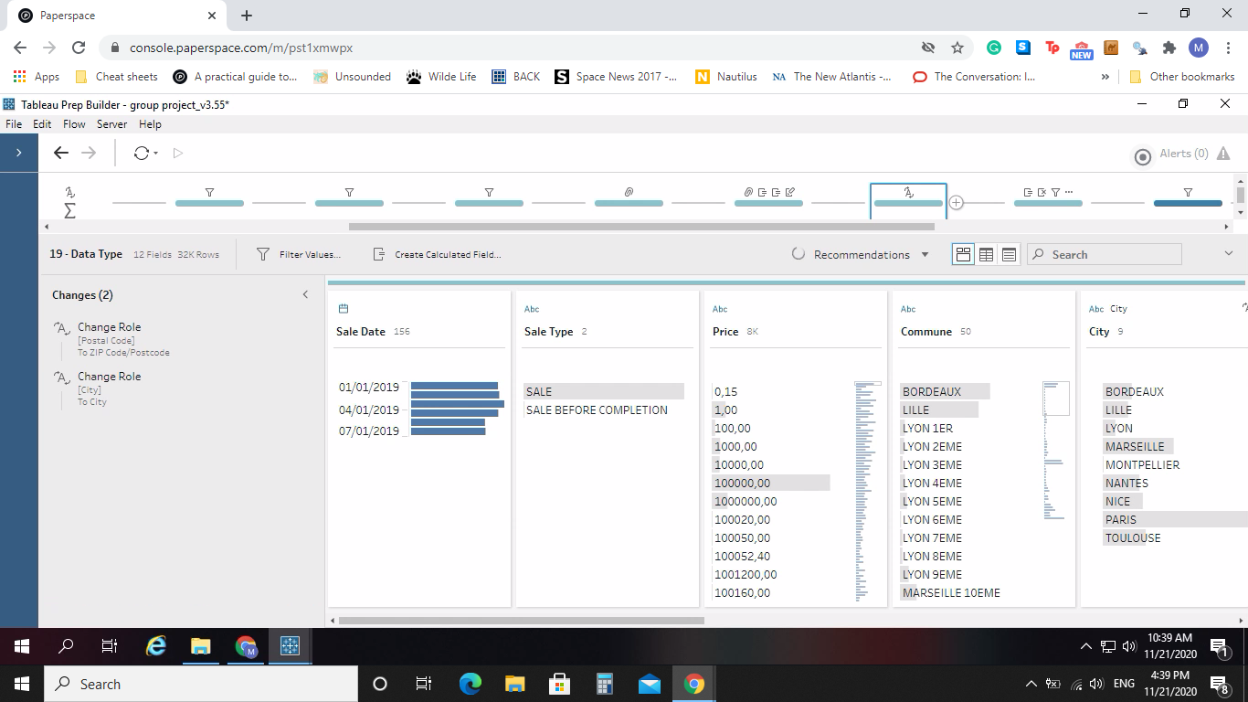
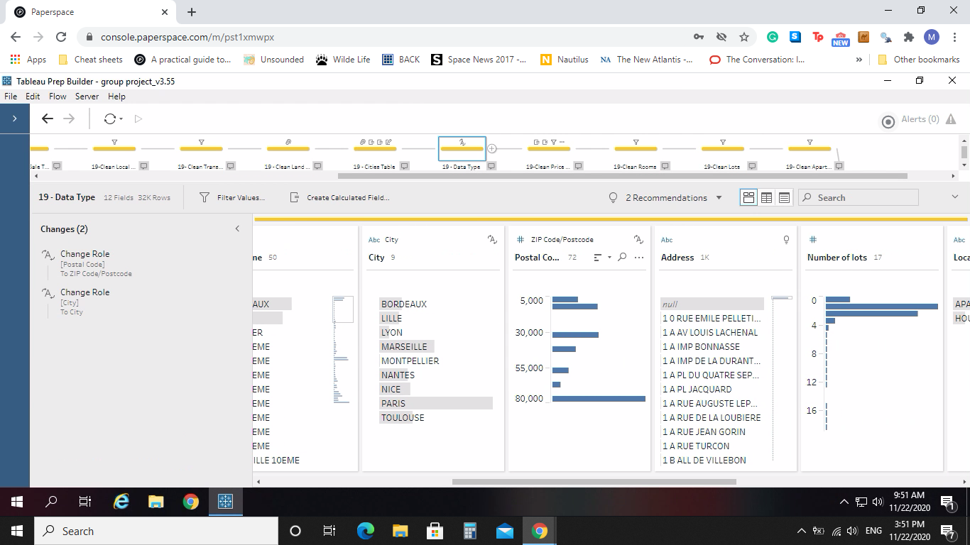
Geographical Data Type
After this, we changed the data type of City and Postal Code. They were changed from a number to their corresponding geographic data type. This was done to help with the analysis for our data in Tableau Desktop and the setting up of our maps.

Slide 15
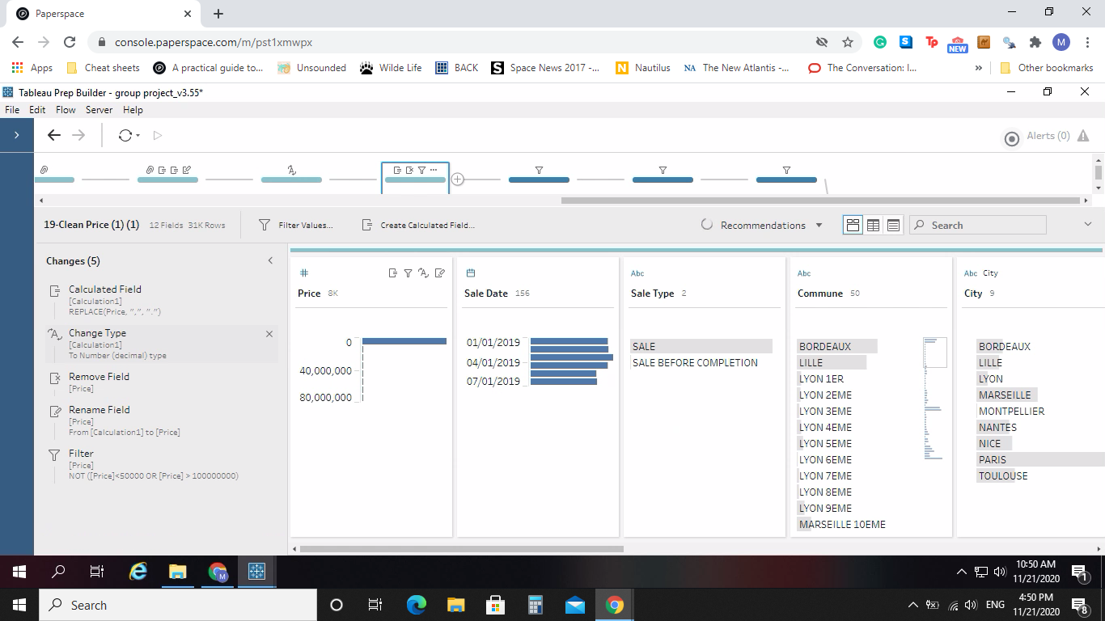
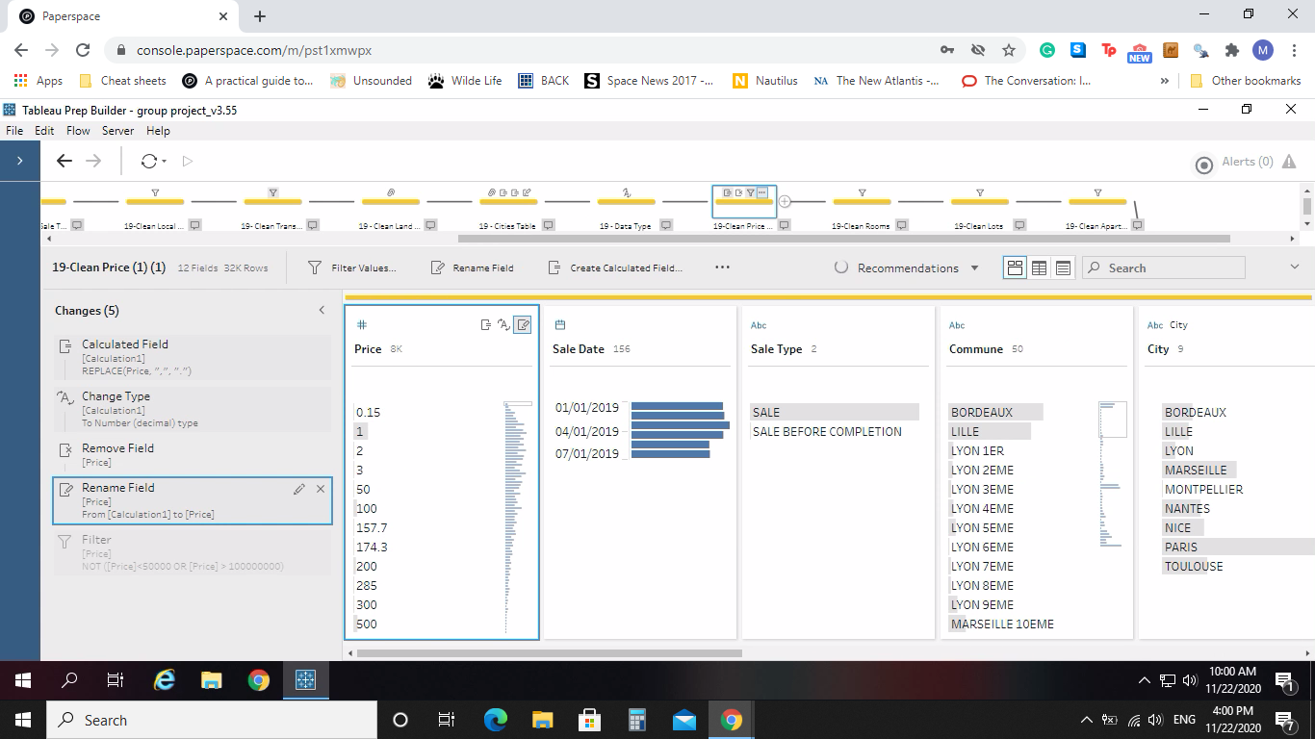

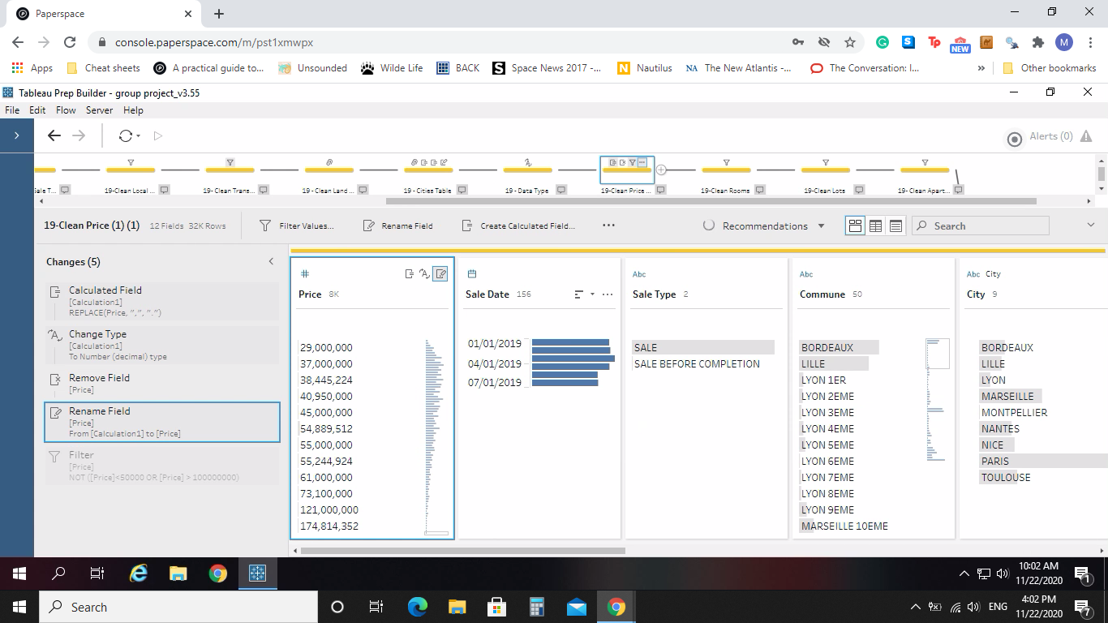
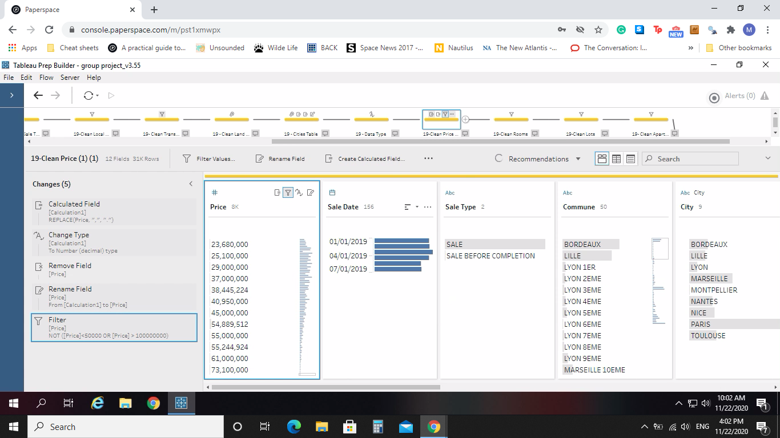
Prices Cleaning & Outliers
Cleaning was done with prices by changing the data type from a string to a decimal number. It was also decided with the cleaning process of the data, that any apartment or house that was sold for less than 50,000 euros or sold for more than 100,000,000 euros were considered outliers and removed.

Slide 16
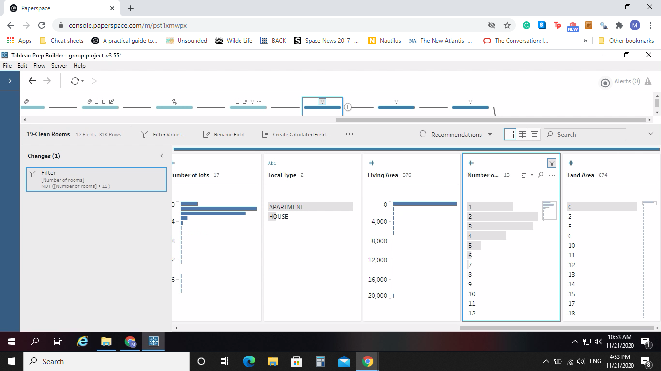
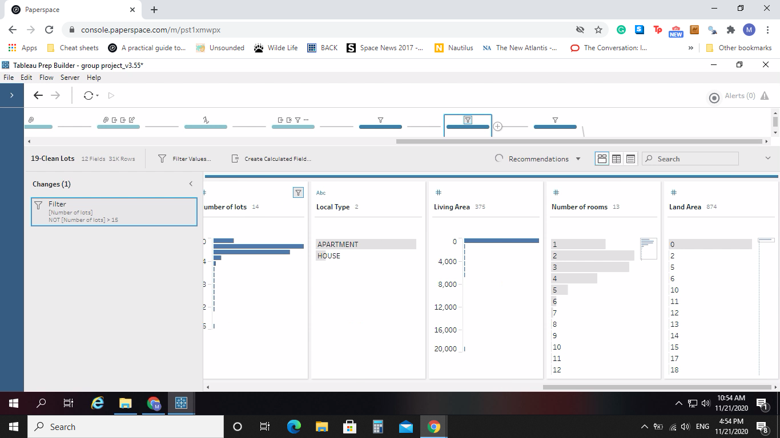
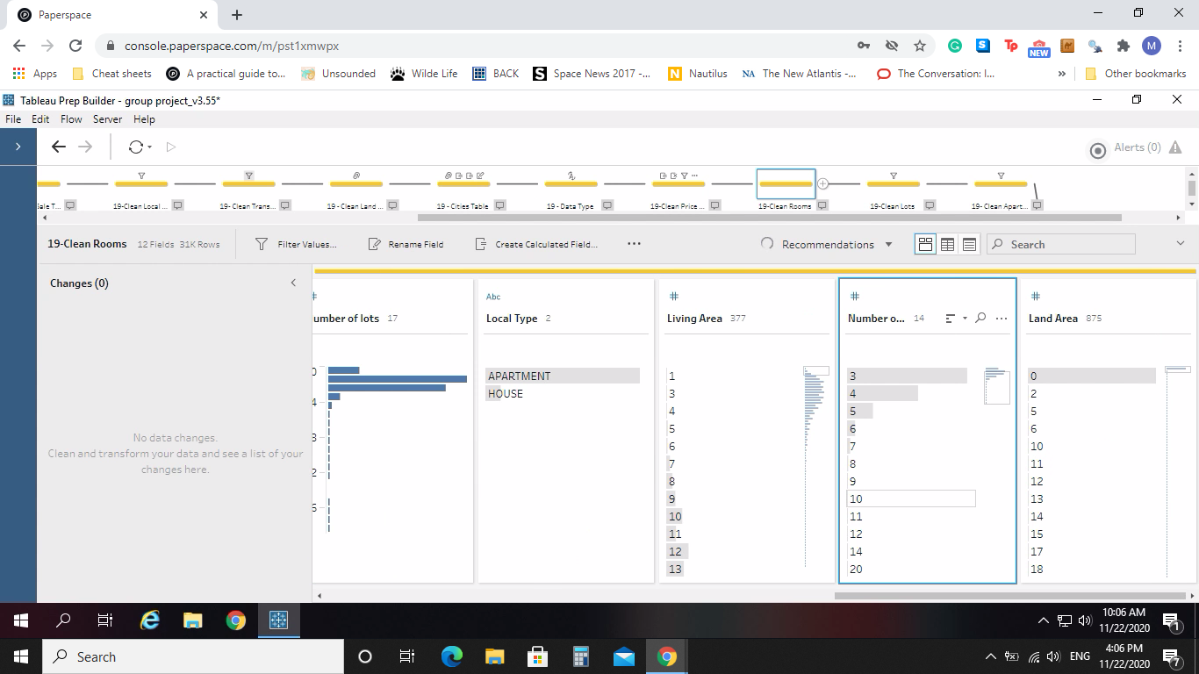
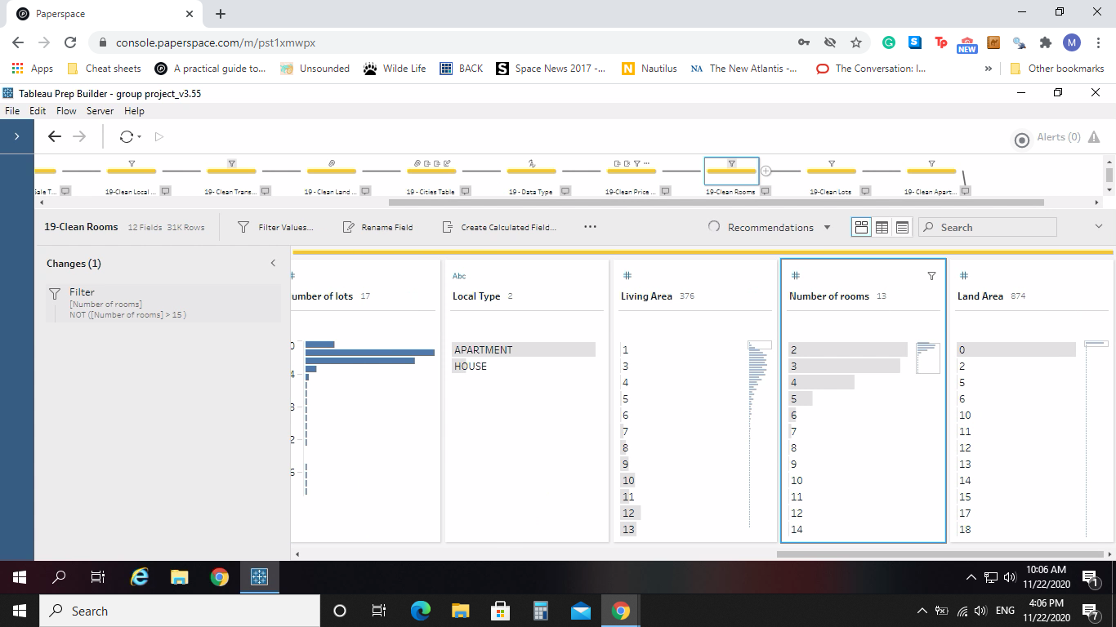
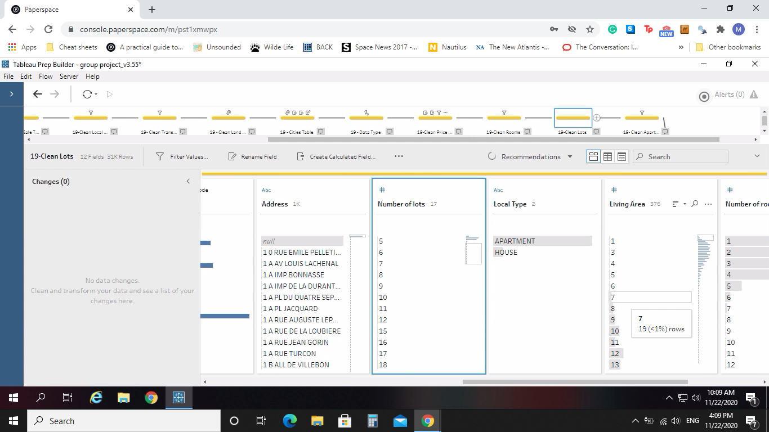
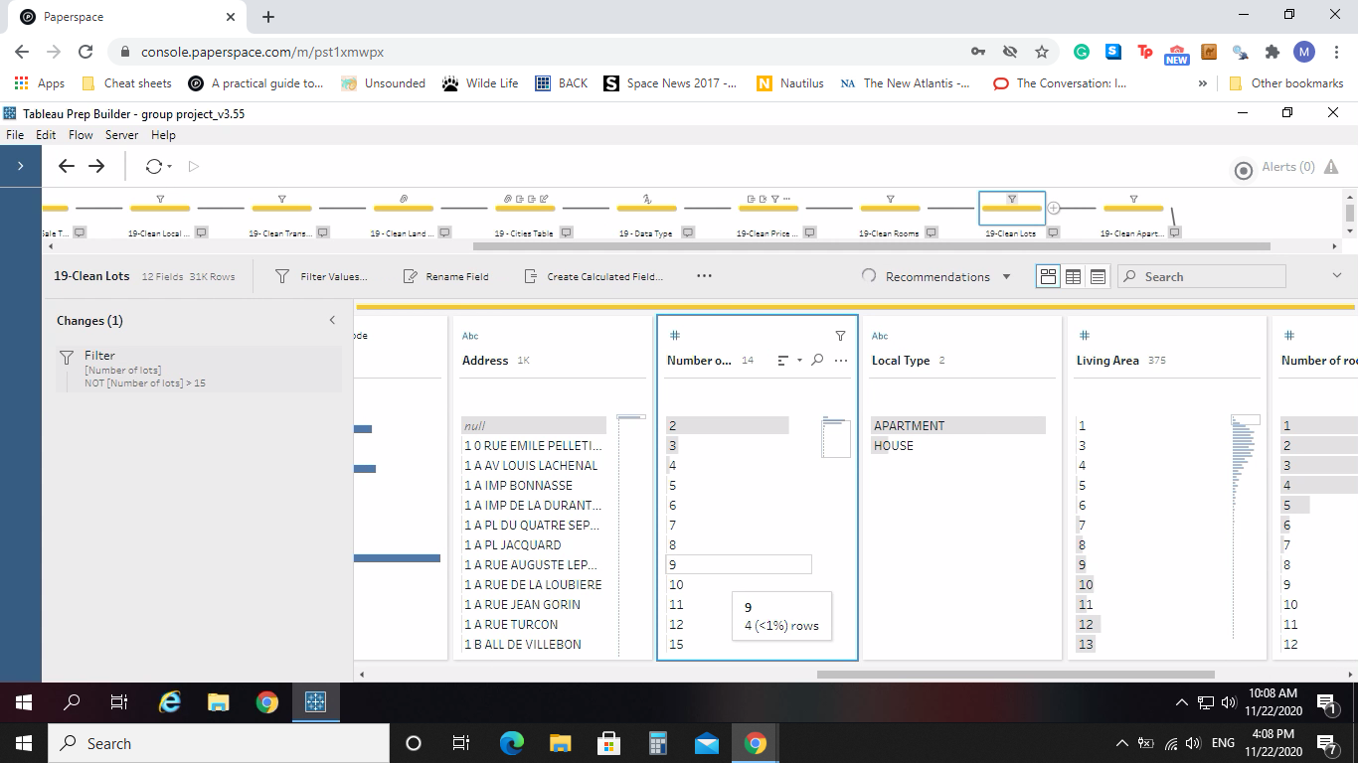
Rooms and Lots Outliers
We also decided to remove data that had more than 15 Rooms or more than 15 Lots

Slide 17
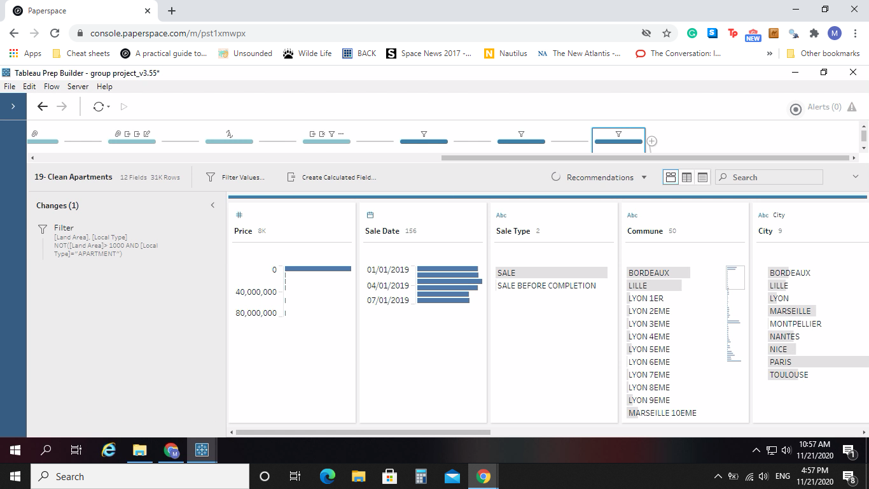
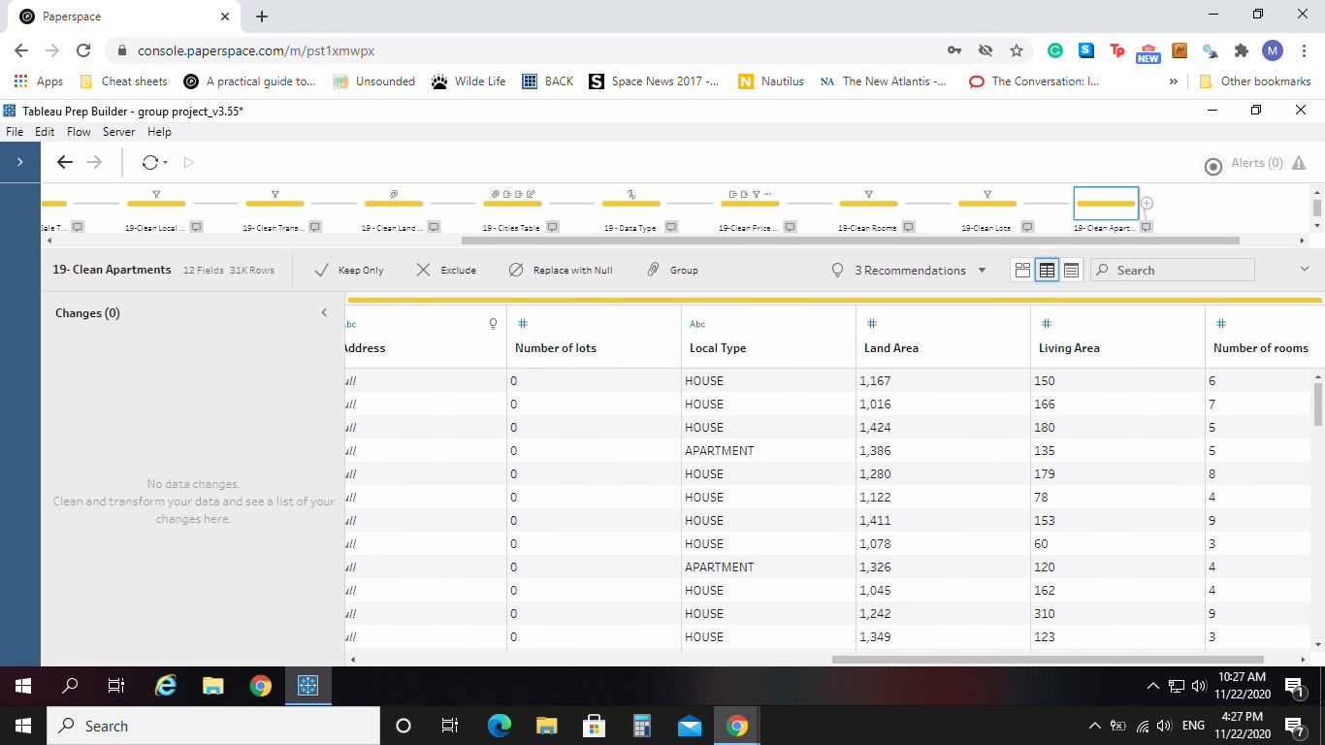
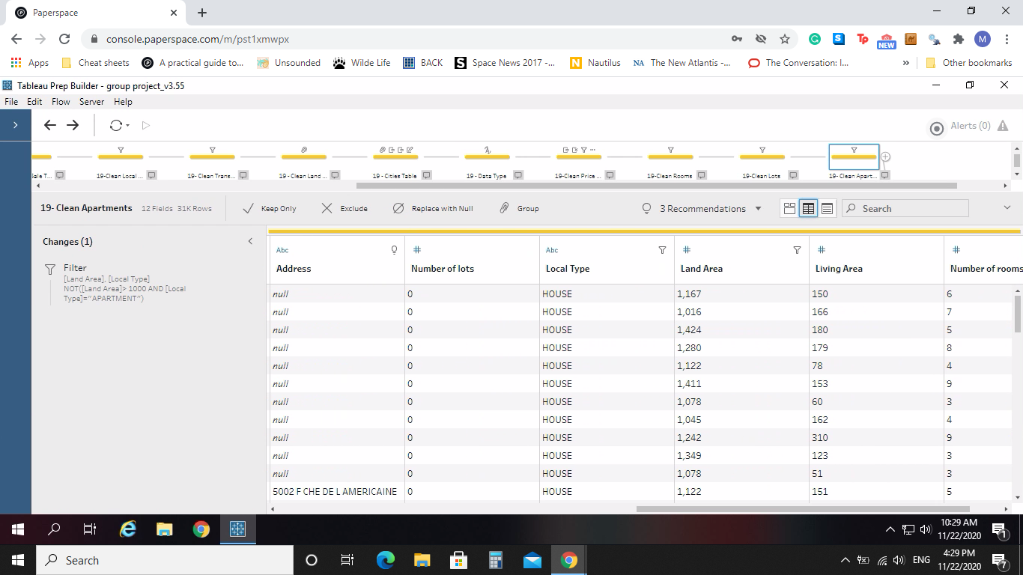
Apartment Outliers
After another analysis of our data, it was agreed to remove apartments that had a Land Area size greater than 1000 square meters as it did not logically make sense that an apartment would have this. This was reinforced after a discussion with the data provider, he also agreed that this was an error and they should be removed.

Slide 18
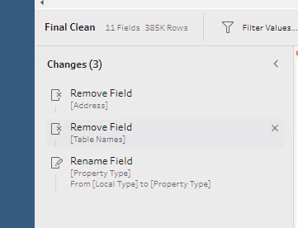
Column removals
Lastly we unioned all the data together into one output. Our last cleaning step was to remove the Addresses and Table Name data as that did not help our final analysis. We also renamed the Local Type to Property Type to make more sense in our analysis.

Slide 19
Dashboard Design
Preattentive Attribute
1
Colour Brightness
2
Colour Saturation
3
Size
These attributes pop-out the different element immediately without any conscious effort.

Slide 20
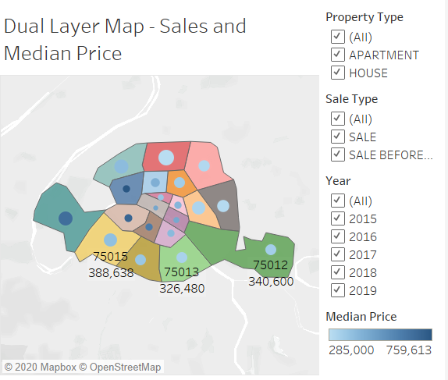
Dashboard Design
Preattentive Attribute - Colour Brightness
Use colour brightness to make contrast the difference in median price among commune in Paris. The users can easily identify the price with the commune. The darker the colour, the higher the median price.

Slide 21
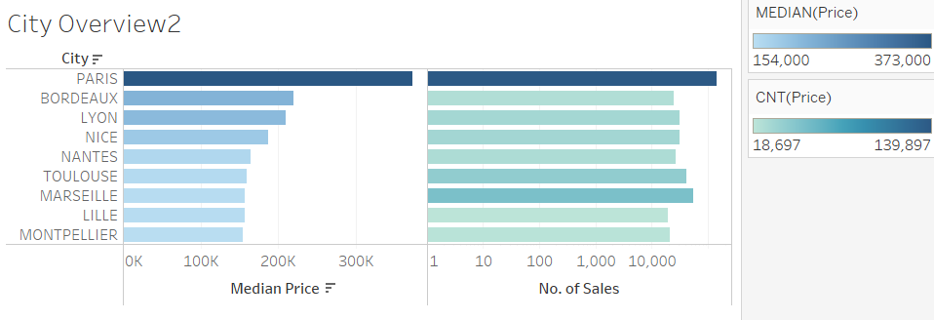
Dashboard Design
Preattentive Attribute - Colour Saturation
Use colour saturation to group similar figures of median price among cities. The users can easily identify the price with the city.
The darker the colour, the higher the median price.

Slide 22
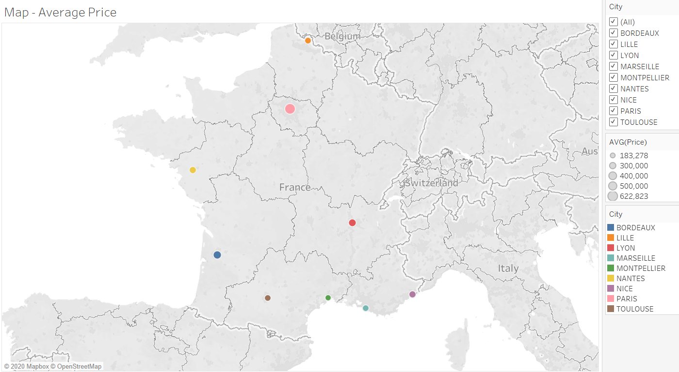
Dashboard Design
Preattentive Attribute - Size
Use size to make contrast the difference in average price among cities.
The bigger the size, the bigger the figure.

Slide 23
Dashboard Design Principles
Simple to Access & Use
Interactive
Colour
Size
GM needs access to it with tablet outside the office
The User can zoom in to a particular point for more details and see the relationships between data
Highlight Important Data with colour
Smaller size for GM’s tablet

Slide 24
Datastory Design Principles
Context, Analysis and Conclusion: From overview to a particular city
Story Structure
Make It Easy
Simple and Direct : Stronger ability to recall and spot the insights
Extend the story parameters into questions & decision making
Direct Discussion
Use different charts, graphs and maps, the data is clearly delineated by colors
Be Visual

Slide 25
Dashboard Design
Minimize user’s cognitive load and highlight the important insights
No 3D effects
Minimize the label in the graph
Uniform colour for each city
Sorting : Descending order
( for comprehension)
Contrast Colour but not too bright
Geographic maps to get a more direct view of the real estate situation in different cities

Slide 26
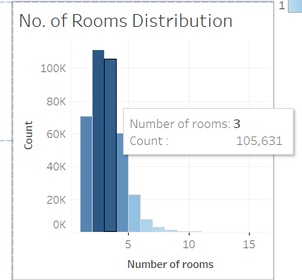
Dashboard Design
Minimize the label in the graph
The details of the graph are shown only when the user points at it, instead of putting every number in the graph

Slide 27
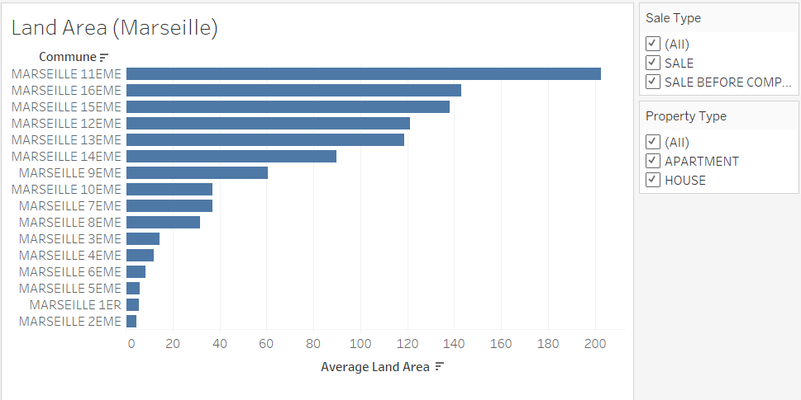
Dashboard Design
Sorting in Descending order
The most important data are highlighted by sorting in descending order, so that the user can spot the insight intuitively. Also it is easier to compare the data.

Slide 28
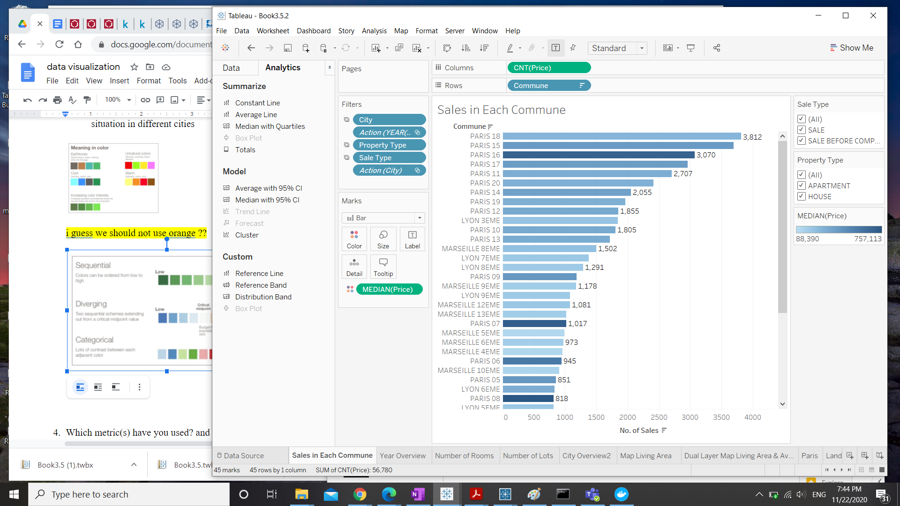
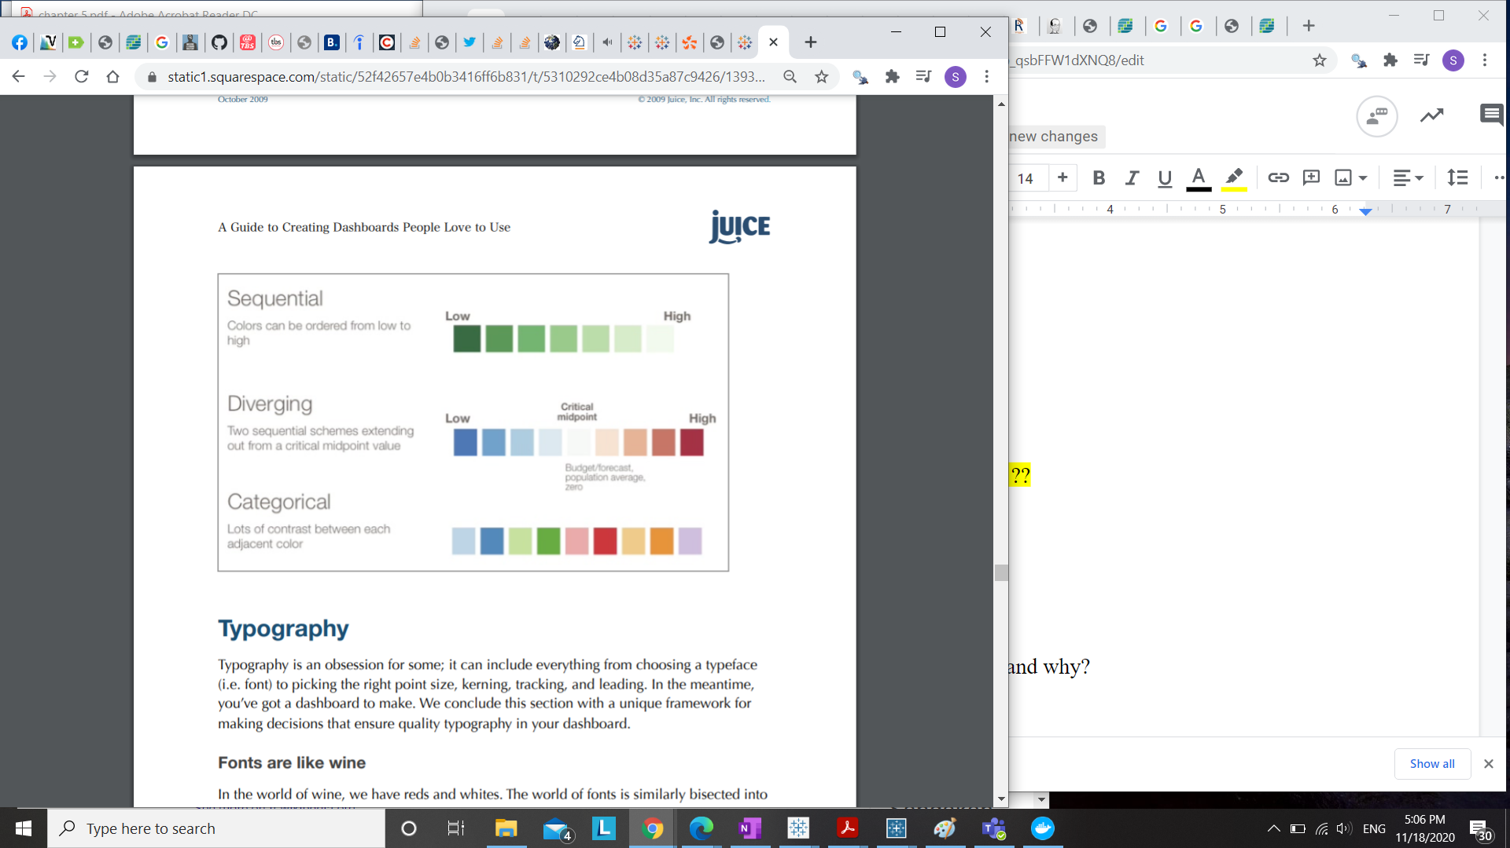
Dashboard Design
Contrast colour
Diverging colours are used for showing the difference of median price. The darker the colour, the more important the data is

Slide 29
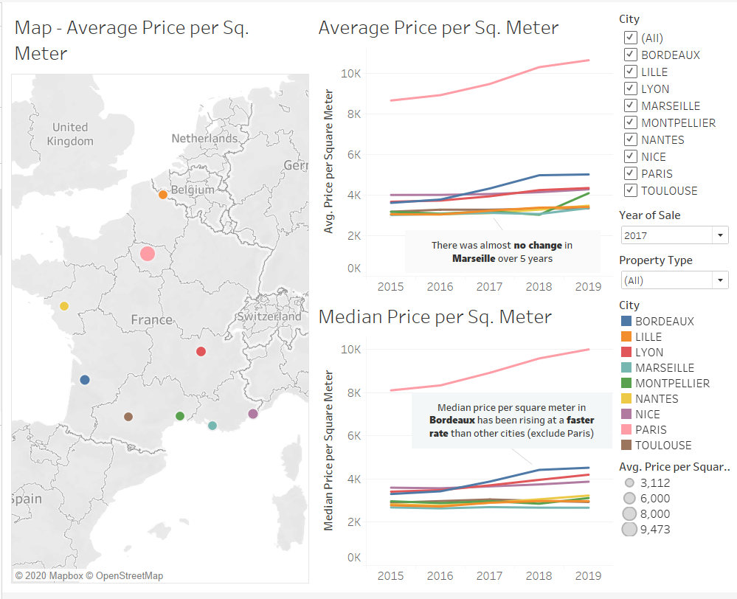
Dashboard Design
Uniform Colours for Cities
Each city is represented by one colour only, so that the user can easily identify each city across the graphs

Slide 30
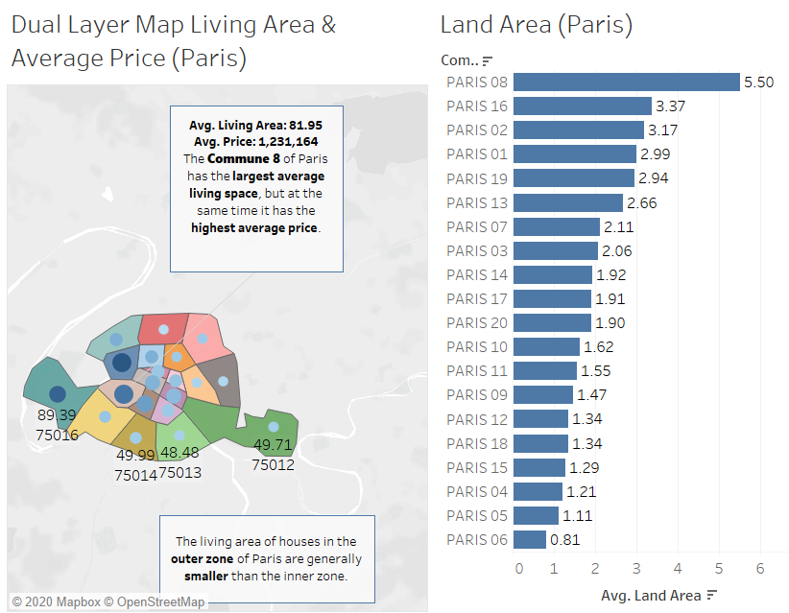
Dashboard Design
Geographic maps
Each commune in Paris is shown on the map for easy recognition as sometimes it is difficult to tell one commune from another in our brain.

Slide 31
Audience’s Needs
Ms. Aude P.
Mr.Gerard T.
Who?
General Manager
(Audience)
Ensure financial stability and efficiency of the company
Marketing Director
(Main user)
Will finally present findings to the executive board
He only has 30 minutes to present the insights
Sometimes likes to play with interactive visualizations
Needs to understand data analysis findings to anticipate next strategies
Quick and clear credible updates
Has access to interactive graph on her tablet to review the insights
Prefers data driven decision making

Slide 32
Audience’s Needs
Audience’s Backgrounds
Purpose of this presentation :
Level of familiarity : high
Help to make short and long term real estate market forecasts, also make marketing strategies based on the analysis of French property market in the past 5 years
They are familiar in real estate market as they are senior manager of a real estate agency
Level of details and information density : Medium
Intended Outcome:
They need some insights with the support of figures for decision making. Only important figures will be needed
Find out the potential growth and opportunities of property market in 9 French cities

Slide 33
Audience’s Needs
What needs?
How to satisfy?
Quick and clear credible updates
Abstract view of each elements : price, sales volume, sales type, property type and cities
Control of the visualization: high
Interactive map to show the difference between districts and cities
Make decision based on the data analysis
Point out the insight from the graphs

Slide 34

Thanks!

